Slide 1
CONSUMER DECISION MAKING PROCESs:
Lesson-10-

Slide 2
Consumer Decision-Making Process.
The consumer decision-making process consists of five steps, which are need recognition, information search, evaluations of alternatives, purchase and post-purchase behavior. These steps can be a guide for marketers to understand and communicate effectively to consumers.

Slide 3
Five stages model
Five Stage Model initially proposed by Cox et al. (1983) is considered to be one of the most common models of consumer decision making process and it involves five various stages. These stages are: recognition of need or problem, information search, comparing the alternatives, purchase and post-purchase evaluation. This simple model clearly illustrates and explains how the consumers make a purchasing decision.
This model’s core focus is on motivational factors which helps the user to understand the reasons behind the purchasing decision easier.

Slide 4
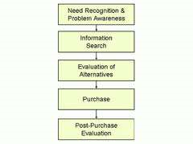

Slide 5
1. Problem/Need Recognition
Recognition of need or a problem is the first stage of the model. Recognition of a problem arises in the situation where an individual realizes the difference between the actual state of affairs and desired state of affairs. This stage depends on different situations and circumstances such as personal or professional and this recognition results in creation of a purchasing idea. For instance, consumer may recognize the need to buy a laptop when there is need to carry it use it in different places which is convenient compared to a desktop computer.
Need recognition often occurs during the process of encountering with the product at various circumstances. In other words, an individual might not be aware of the need for a specific product until he encounters with the product as a result of engaging in ‘window-shopping’, media advertisements, or in a range of other circumstances.
The human need has no limit therefore; the problem recognition is a repetitive in nature. According to Maslow theory, human being is always dissatisfied, when an individual’s one need is satisfied another one will come out and this trend continues repetitively.

Slide 6
The buying process starts when the buyer recognizes a problem or need triggered by internal or
external stimuli. With an internal stimulus, one of the person’s normal needs—hunger, thirst, sex—
rises to a threshold level and becomes a drive. A need can also be aroused by an external stimulus.
A person may admire a friend’s new car or see a television ad for a Hawaiian vacation, which
inspires thoughts about the possibility of making a purchase.
Marketers need to identify the circumstances that trigger a particular need by gathering information from a number of consumers. They can then develop marketing strategies that spark
consumer interest. Particularly for discretionary purchases such as luxury goods, vacation
packages, and entertainment options, marketers may need to increase consumer motivation so a
potential purchase gets serious consideration.

Slide 7
2. Information Search:
The next stage of the model is information search. Once the need is recognized, the consumer is likely to search more product-related information before directly making a purchase decision. However, different individuals are involved in search process differently depending on their knowledge about the product, their previous experience or purchases or on some external information such as feedback from others.
Search of information process itself can be divided into two parts: the internal search and external search. In internal search, the consumers compare the alternatives from their own experiences and memories depending on their own past experiences and knowledge. For example, searching for fast food can be an example for internal search because customers often use their knowledge and tastes to choose the right product they need rather than asking someone for an advice. On the other hand, external search ends to be for bigger purchases such as home appliances or gadgets. For instance, consumers who wish to buy new furniture or a mobile phone tend to ask friends’ opinion and advices or search in the magazines and media before making a purchasing decision.
With the enhancing role of internet in professional and personal lives of people, increasing numbers of individuals are turning to various resources in internet when searching for information about product categories or specific brands.
The nature of influence of peers, friends and family members upon information search and consumer decision making process in general depends on a range of factors such as the nature of relationships, the level of personal influence, the extent of ‘opinion leadership’ associated with specific individuals etc.

Slide 8
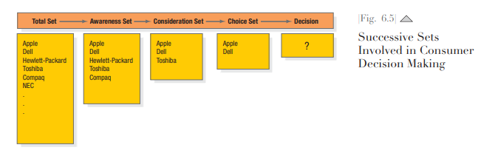

Slide 9
Today, many buyers decide first on the nation from which they want to buy a car (nation-dominant hierarchy). Buyers may first decide they want to buy a German car, then Audi, and then the A4 model of Audi.

Slide 10
3. Evaluation of Alternatives:
After gathering enough information at the first stage, the consumer gets into comparing and evaluating that information in order to make the right choice. In this stage the consumer analyzes all the information obtained through the search and considers various alternative products and services compares them according to the needs and wants. Moreover, another various aspects of the product such as size, quality, brand and price are considered at this stage. Therefore, this stage is considered to be the most important stage during the whole consumer decision making process.
Furthermore, the process of evaluation of alternatives can sometimes be difficult, time consuming and full of pressure for a consumer. This is because it is quite hard to find an ideal product or service that satisfies the needs of the customer as there are numerous factors that hinder the consumer purchasing decision making process. For instance, when it comes to online hotel reservation or furniture purchasing evaluation process, it can be quite complex. Several factors and aspects need to be considered before making a purchasing decision. Factors such as age, culture, taste and budget have all impact on the evaluation process by the consumer. For example, when purchasing a furniture, the young people consider the factors such as convenience and price where as the old people are likely to consider the quality and design.
Moreover, celebrity endorsement is seen as another factor with great potential impact on evaluation of alternatives stages of consumer decision making process.

Slide 11
Some basic concepts will help us understand consumer evaluation processes: First, the consumer is trying to satisfy a need. Second, the consumer is looking for certain benefits from the
product solution. Third, the consumer sees each product as a bundle of attributes with varying
abilities to deliver the benefits. The attributes of interest to buyers vary by product—for example:
1. Hotels—Location, cleanliness, atmosphere, price
2. Mouthwash—Color, effectiveness, germ-killing capacity, taste/flavor, price
3. Tires—Safety, tread life, ride quality, price
Consumers will pay the most attention to attributes that deliver the sought-after benefits. We
can often segment the market for a product according to attributes and benefits important to
different consumer groups.

Slide 12
4. Purchase Decision:
Once the information search and evaluation process is over, the consumer makes the purchasing decision. In this stage, the consumer makes decision to make a final purchase as he or she has already reviewed all the alternatives and came to a final decision point. Purchased further can be classified into three different types: planned purchase, partially purchase and impulse purchase.
There are a number of factors that can affect the purchasing process. For example, the desired product may not be available at the stock. In this case the purchase process is delayed and consumer
may consider buying the product through online stores rather than visiting traditional physical stores.
Department store sales assistants play in integral role in terms of impacting consumer purchase decision in a positive way from a business point of view. At the same time this impact must not be done in a pushy manner, in which case it can prove to be counter-productive.

Slide 13
5. Post-Purchase Evaluation:
The final stage in the consumer decision making process is post-purchase evaluation stage. Many companies tend to ignore this stage as this takes place after the transaction has been done. However, this stage can be the most important one as it directly affects the future decision making processes by the consumer for the same product. Therefore this stage reflects the consumer’s experience of purchasing a product or service. The consumer decision making process is a repetitive action and a good experience is vital in reducing the uncertainty when the decision to purchase the same product or service is considered the next time.
The opinions of peers, friends and family regarding the purchases made is specified as one of the most important factors affecting the outcome of post-purchase evaluation. Peer opinions regarding product evaluations tend to impact customer level of satisfaction regardless of their level of objectivity.
At this stage, the consumer may either get satisfaction or dissatisfaction depending on the evaluation of the purchase and comparison of their own expectations. The outcome forms the experience of the customer and this experience is believed to have a direct impact on the next decision of the consumer to purchase the same product from the same seller

Slide 14
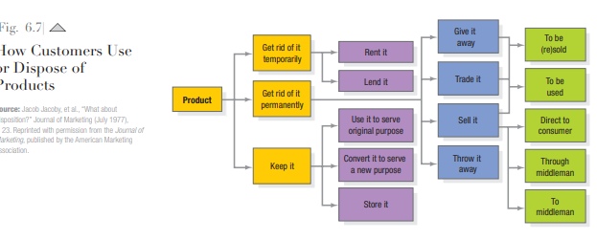

Slide 15
Oral B has tied toothbrush promotions to the springtime switch to daylight savings time.
Another strategy is to provide consumers with better information about either (1) the time they first used the product or need to replace it or (2) its current level of performance. Batteries have built-in gauges that show how much power they have left; toothbrushes have color indicators to indicate when the bristles are worn; and so on. Perhaps the simplest way to increase usage is to learn when actual usage is lower than recommended and persuade customers that more regular usage has benefits, overcoming potential hurdles.
If consumers throw the product away, the marketer needs to know how they dispose of it, especially if—like batteries, beverage containers, electronic equipment, and disposable diapers—it can damage the environment. There also may be product opportunities in disposed products: Vintage clothing shops, such as Savers, resell 2.5 billion pounds of used clothing annually; Diamond Safety buys finely ground used tires and then makes and sells playground covers and athletic fields; and, unlike the usual potato chip maker, which discards some of the spud, Pringles converts the whole
potato into dehydrated potato flakes that are rolled and cut into chips

Slide 16
limits of the classic model
Positivist researchers theorize that consumers act rationally in a complex linear way:
1- Problem recognition
2-Information search
3-Alternative evaluation
4-Choice (or purchase decision)
5-Outcome evaluation (or post-purchase behavior)
Consider this process in your life.
On what occasions did you go through the five-step process from beginning to the end? Perhaps you needed a car, searched information on cars through friends and other sources, evaluated selected cars against your criteria, decided on your car and then evaluated whether you had made the right decision. Or did you stop at alternative evaluation, thereby completing only the first three steps?
Did you need a holiday, decide immediately to return to your favorite holiday destination (a search of your memory, perhaps) and then share your satisfaction after your choice? You would then not have gone through the five steps of the decision-making process.
Have you recognized a problem (for example, replacing your printer cartridge or designer bag) and gone directly to choose, without outcome evaluation because you are already familiar with the product category?
Maybe you were in a supermarket and bought potato chips on special, even though the item was not on your shopping list. With your impulse purchase, you would have skipped several steps of the decision-making process.
The above scenarios show that the traditional cognitive decision-making process does not apply in all situations for all product categories. It generally applies when you have to buy something very important and consider the financial, personal and social risks. In most cases, however, there are emotional, personal and situational factors for first-time and repeat purchases where the traditional decision-making model does not apply. Hence, interpretivist researchers advocate a subjective situational approach to consumer decision making.

Slide 17
A simple approach:
1- Stimulus of a situation or object
2- Person receives stimulus
3-Person acts.
McKinsey has advocated moving away from the ‘funnel’ process of awareness–familiarity–consideration–purchase–loyalty. He recommends a circular rather than a linear process covering brand consideration, evaluation, purchase and post-purchase. Consumers consider brands that they are familiar with; they then actively seek internet reviews and word-of-mouth recommendations of family and friends before purchasing; and then become active loyal consumers or passive loyalists.

